Slide 1


Multi-physics Design Optimization of a GaN Based Integrated Modular Motor Drive System
The 9th International Conference on Power Electronics, Machines and Drives
Mesut Uğur
mesut.ugur@metu.edu.tr
Department of Electrical and Electronics Engineering
Middle East Technical University
19.04.2018

Slide 2

Outline
Motivation
System model
Evaluation with design parameters
Optimum system design
Conclusions
References

Slide 3
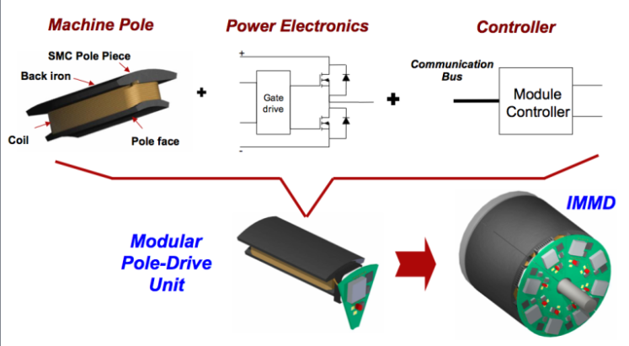
Motivation
Integrated Modular Motor Drive
Increased power density
Reduced cost
Reduced EMI
Fault tolerance
Redundancy
Reduced stress
Shea, A., & Jahns, T. M. (2014). Hardware integration for an integrated modular motor drive including distributed control. In 2014 IEEE Energy Conversion Congress and Exposition (ECCE) (pp. 4881–4887). IEEE.

Slide 4
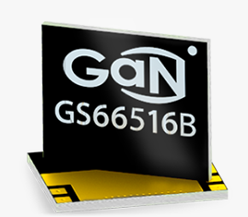
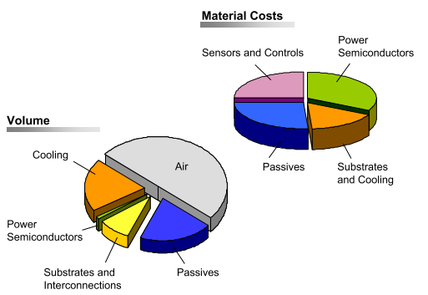
Motivation
Design Challenges
Limited space available
Inter-dependencies between parts
Thermal management
Design optimization
Careful layut design
Detailed modeling

Slide 5
System Model

Slide 6
System Model

Slide 7
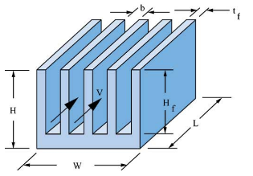
System Model
$$R_{th−sa−min}=\left(T_{jmax}−T_{amb}\right)/\left(nP_{loss}\right)−R_{th1}/n$$
$$R_{th−sa}={\left[h \left(A_{base}+N_{fin}η_{fin}A_{fin}\right)\right]}^{−1}$$

Slide 8
System Evaluation

Slide 9
System Evaluation

Slide 10
System Evaluation

Slide 11
System Evaluation

Slide 12
Optimum System Design

Slide 13


Thank you !
Mesut Uğur
mesut.ugur@metu.edu.tr
Department of Electrical and Electronics Engineering
Middle East Technical University
power.eee.metu.edu.tr

